Slide 1
Object Oriented Software Engineering (OOSE)
22CS017
Introduction to Design concepts and Analysis

Slide 3
Index
Design concepts and model
Data design, Quality Software
Design Principles
Architectural design
Design class based components
User interface analysis and its design

Slide 4
Objectives
Outline the concepts and principles underpinning design
Abstraction and Refinement
Modularity
Cohesion and Coupling
Information Hiding
Present some criteria for good design
Figure 1: Criteria for Good design
analysis
design
code
test
test

Slide 5
Overview of Design
What is it? A meaningful engineering representation of something that is to be built.
Who does it? Software engineers with a variety of skills, ranging from human ergonomics to computer architecture
Why is it important? A house would never be built without a blueprint. Why should software? Without design the system may fail with small changes, is difficult to test and cannot be assessed for quality
What is the work product? A design specification

Slide 6
Designing Quality Software
Design is the stage where quality is instilled
Design is assessed by formal review or walkthrough
Characteristics of a good design:
Must implement explicit requirements and accommodate implicit requirements
Must be a readable and understandable guide for coding and testing
Should provide a complete picture of the software from an implementation perspective

Slide 7
Generic Design Process
The design process involves:
Diversification (acquisition of alternatives)
Followed By
Convergence (elimination of all but one particular configuration)
All design methods have the following characteristics:
A mechanism for the translation of the analysis model into a design representation
A notation for representing functional components and their interfaces
Heuristics for refinement and partitioning
Guidelines for quality assessment

Slide 8
Software Design Process
The design phase of software development deals with transforming the customer requirements as described in the SRS documents into a form implementable using a programming language. The software design process can be divided into the following three levels or phases of design:
Interface Design
Architectural Design
Detailed Design

Slide 9
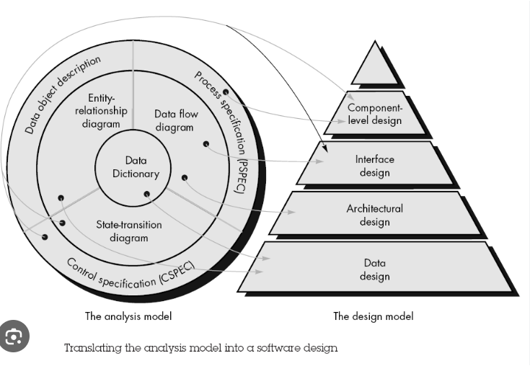
Cont..

Slide 10
Elements of a System
Architecture: This is the conceptual model that defines the structure, behavior, and views of a system. We can use flowcharts to represent and illustrate the architecture.
Modules: These are components that handle one specific task in a system. A combination of the modules makes up the system.
Components: This provides a particular function or group of related functions. They are made up of modules.
Interfaces: This is the shared boundary across which the components of a system exchange information and relate.
Data: This is the management of the information and data flow.

Slide 11
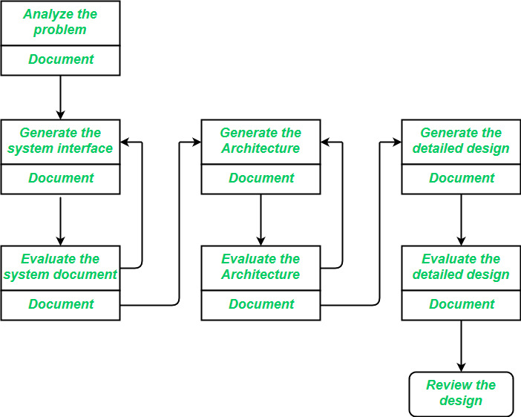
Software Design Process

Slide 12
Interface Design
Interface Design
Interface design is the specification of the interaction between a system and its environment. This phase proceeds at a high level of abstraction with respect to the inner workings of the system i.e, during interface design, the internal of the systems are completely ignored, and the system is treated as a black box. Attention is focused on the dialogue between the target system and the users, devices, and other systems with which it interacts. The design problem statement produced during the problem analysis step should identify the people, other systems, and devices which are collectively called agents.
Interface design should include the following details:
Precise description of events in the environment, or messages from agents to which the system must respond.
Precise description of the events or messages that the system must produce.
Specification of the data, and the formats of the data coming into and going out of the system.
Specification of the ordering and timing relationships between incoming events or messages, and outgoing events or outputs.

Slide 13
Architectural Design
Architectural Design
Architectural design is the specification of the major components of a system, their responsibilities, properties, interfaces, and the relationships and interactions between them. In architectural design, the overall structure of the system is chosen, but the internal details of major components are ignored. Issues in architectural design includes:
Gross decomposition of the systems into major components.
Allocation of functional responsibilities to components.
Component Interfaces.
Component scaling and performance properties, resource consumption properties, reliability properties, and so forth.
Communication and interaction between components.
The architectural design adds important details ignored during the interface design. Design of the internals of the major components is ignored until the last phase of the design.

Slide 14
Detailed Design
Detailed Design
Design is the specification of the internal elements of all major system components, their properties, relationships, processing, and often their algorithms and the data structures. The detailed design may include:
Decomposition of major system components into program units.
Allocation of functional responsibilities to units.
User interfaces.
Unit states and state changes.
Data and control interaction between units.
Data packaging and implementation, including issues of scope and visibility of program elements.
Algorithms and data structures.

Slide 15
Where Do We Begin?
modelling
Prototype
Spec
Design
Figure 2: Beginning Steps

Slide 16
Quality Guidelines
Quality Guidelines
In order to evaluate the quality of a design representation, consider the following guidelines:
A design should exhibit an architecture that (1) has been created using recognizable architectural styles or patterns, (2) is composed of components that exhibit good design characteristics and (3) can be implemented in an evolutionary fashion, thereby facilitating implementation and testing.
A design should be modular; that is, the software should be logically partitioned into elements or subsystems.
A design should contain distinct representations of data, architecture, interfaces, and components.
A design should lead to data structures that are appropriate for the classes to be implemented and are drawn from recognizable data patterns.
A design should lead to components that exhibit independent functional characteristics.
A design should lead to interfaces that reduce the complexity of connections between components and with the external environment.
A design should be derived using a repeatable method that is driven by information obtained during software requirements analysis.
A design should be represented using a notation that effectively communicates its meaning.

Slide 17
Quality Attributes
Quality Attributes
Hewlett-Packard developed a set of software quality attributes that has been given the acronym FURPS—functionality, usability, reliability, performance, and supportability. The FURPS quality attributes represent a target for all software design:
• Functionality is assessed by evaluating the feature set and capabilities of the program, the generality of the functions that are delivered, and the security of the overall system..
• Usability is assessed by considering human factors, overall aesthetics, consistency, and documentation.
• Reliability is evaluated by measuring the frequency and severity of failure, the accuracy of output results, the mean-time-to-failure (MTTF), the ability to recover from failure, and the predictability of the program.
• Performance is measured by considering processing speed, response time, resource consumption, throughput, and efficiency.
• Supportability combines the ability to extend the program (extensibility), adaptability, serviceability—these three attributes represent a more common term, Maintainability— and in addition, testability, compatibility, configurability, the ease with which a system can be installed, and the ease with which problems can be localized.

Slide 18
DESIGN CONCEPTS
A set of fundamental software design concepts has evolved over the history of software engineering. Each provides the software designer with a foundation from which more sophisticated design methods can be applied. Each helps you answer the following questions:
• What criteria can be used to partition software into individual components?
• How is function or data structure detail separated from a conceptual representation of the software?
• What uniform criteria define the technical quality of a software design?
The following brief overview of important software design concepts that span both traditional and object-oriented software development

Slide 19
Software Design Concepts
Concepts are defined as a principal idea or invention that comes into our mind or in thought to understand something.
The software design concept simply means the idea or principle behind the design.
It describes how you plan to solve the problem of designing software, and the logic, or thinking behind how you will design software.
It allows the software engineer to create the model of the system software or product that is to be developed or built.
The software design concept provides a supporting and essential structure or model for developing the right software.
There are many concepts of software design and some of them are given below:

Slide 20
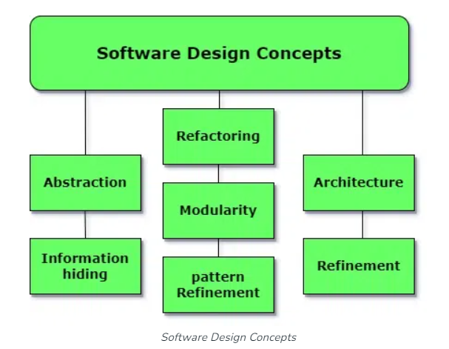
Cont..

Slide 21
Cont..
1. Abstraction (Hide Irrelevant data): Abstraction simply means to hide the details to reduce complexity and increase efficiency or quality. Different levels of Abstraction are necessary and must be applied at each stage of the design process so that any error that is present can be removed to increase the efficiency of the software solution and to refine the software solution. The solution should be described in broad ways that cover a wide range of different things at a higher level of abstraction and a more detailed description of a solution of software should be given at the lower level of abstraction.
2. Modularity (subdivide the system): Modularity simply means dividing the system or project into smaller parts to reduce the complexity of the system or project. In the same way, modularity in design means subdividing a system into smaller parts so that these parts can be created independently and then use these parts in different systems to perform different functions. It is necessary to divide the software into components known as modules because nowadays, there are different software available like Monolithic software that is hard to grasp for software engineers. So, modularity in design has now become a trend and is also important. If the system contains fewer components then it would mean the system is complex which requires a lot of effort (cost) but if we can divide the system into components then the cost would be small.

Slide 22
Cont..
3. Architecture (design a structure of something): Architecture simply means a technique to design a structure of something. Architecture in designing software is a concept that focuses on various elements and the data of the structure. These components interact with each other and use the data of the structure in architecture.
4. Refinement (removes impurities): Top-down approach (Refinement) step by step, simply means to refine something to remove any impurities if present and increase the quality. The refinement concept of software design is a process of developing or presenting the software or system in a detailed manner which means elaborating a system or software. Refinement is very necessary to find out any error if present and then to reduce it.
5. Pattern (a Repeated form): A pattern simply means a repeated form or design in which the same shape is repeated several times to form a pattern. The pattern in the design process means the repetition of a solution to a common recurring problem within a certain context.

Slide 23
Cont..
6. Information Hiding (Hide the Information): Information hiding simply means to hide the information so that it cannot be accessed by an unwanted party. In software design, information hiding is achieved by designing the modules in a manner that the information gathered or contained in one module is hidden and can’t be accessed by any other modules.
7. Functional Independence: The concept of functional independence is a direct outgrowth of separation of concerns, modularity, and the concepts of abstraction and information hiding. Functional independence is achieved by developing modules with “single minded” function and an “aversion” to excessive interaction with other modules.
Independence is assessed using two qualitative criteria: cohesion and coupling.
Cohesion is an indication of the relative functional strength of a module. Coupling is an indication of the relative interdependence among modules. Cohesion is a natural extension of the information-hiding concept. A cohesive module performs a single task, requiring little interaction with other components in other parts of a program. Stated simply, a cohesive module should do just one thing. Although you should always strive for high cohesion (i.e., single-mindedness).
Coupling is an indication of interconnection among modules in a software structure. Coupling depends on the interface complexity between modules, the point at which entry or reference is made to a module, and what data pass across the interface. In software design, you should strive for the lowest possible coupling.

Slide 24
Cont..
7. Refactoring (Reconstruct something): Refactoring simply means reconstructing something in such a way that it does not affect the behavior of any other features. (Internal changes do not affect the actual output of the module) Refactoring in software design means reconstructing the design to reduce complexity and simplify it without impacting the behavior or its functions. Fowler has defined refactoring as “the process of changing a software system in a way that it won’t impact the behavior of the design and improves the internal structure”.

Slide 25
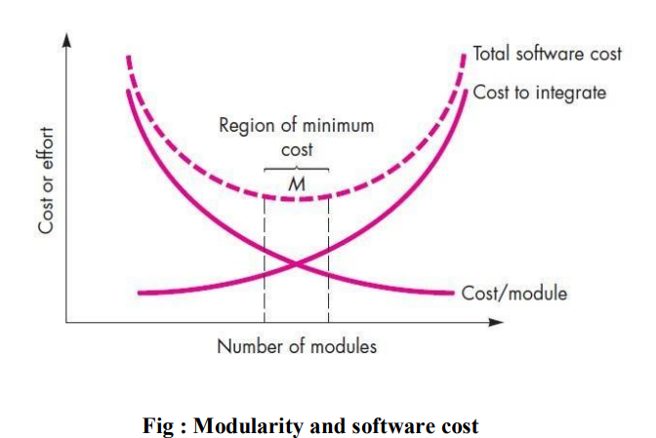
Cont..

Slide 27
Design Principles
The Design process and spec should:
Avoid ‘tunnel vision’
Be traceable back to analysis
Not reinvent the wheel
“Minimize the intellectual distance” between the problem and the solution
Exhibit uniformity and integration (look like the work of a single designer)
Accommodate change
Degrade gently
Be assessed for quality as it is being created, not after the fact
Not miss the forest (not focus too much on minutiae)
Recognize that design is not coding, coding is not design

Slide 28
Abstraction and Refinement
Abstraction:
“Abstraction permits one to concentrate on a problem at some level of generalization without regard to irrelevant low level details..”
Software Engineering is a process of refining abstractions
Modern programming languages allow for abstraction, e.g. abstract data types
Types: data, procedural and control
Stepwise refinement
gradual top-down elaboration of detail
Abstraction and refinement are complementary. Abstraction suppresses low-level detail while refinement gradually reveals it.

Slide 29
Data Abstraction
door
A named collection of data that describes a data object
manufacturer
model number
type
swing direction
inserts
type
lights
number
weight
Opening mechanism
implemented as a data structure
Figure 3: Data Abstraction

Slide 30
Procedural Abstraction
A named sequence of instructions with a specific and limited function
open
details of enter
algorithm
implemented with a "knowledge" of the
object that is associated with enter
Figure 4: Procedural Abstraction

Slide 31
Stepwise Refinement
open
Process of elaboration, proposed by Niklaus Wirth, that decomposes a high-level statement of function until low-level programming language statements are reached
1. walk to door;
2. reach for knob;
repeat until door opens
3. open door;
turn knob clockwise;
if knob doesn't turn, then
4. walk through;
take key out;
5. close door.
find correct key;
insert in lock;
endif
pull/push door
move out of way;
end repeat
Figure 5: Stepwise Refinement

Slide 32
Modularity
Beware the Monolith
Software should be split into separately named and addressable components
A Module is “a lexically contiguous sequence of program statements, bounded by boundary elements, having an aggregate identifier” [Yourdon and Constantine 1979]
Procedures, functions and objects are all modules

Slide 33
Benefits of Modularity
Easier to build; easier to change; easier to fix
“Modularity is the single attribute of software that allows a program to be intellectually manageable”
Don’t overdo it. Too many modules makes integration complicated
Sometimes the code must be monolithic (e.g. real-time and embedded software) but the design still shouldn’t be
Effective modular design is achieved by developing “single minded” (highly cohesive) modules with an “aversion” to excessive interaction (low coupling)

Slide 34
Modularity: Trade-offs
What is the "right" number of modules for a specific software design ?
module development cost
cost of
software
module
integration
cost
optimal number
number of modules
of modules
Figure 6: Modularity

Slide 35
Modularity Support
A design method supports effective modularity if it evidences:
Decomposability - a systematic mechanism for decomposing the problem
Composability - able to reuse modules in a new system
Understandability - the module can be understood as a standalone unit
Continuity - minimizes change-induced side effects
Protection - minimizes error-induced side effects

Slide 36
Cohesion
Def: the degree of interaction within a module
A measure of functional strength; strive for high cohesion
Terminology:
Action = the behaviour of a module (e.g. compute square root)
Logic = how the module performs its action (e.g. using Newton’s method)
Context = specific usage of the module (e.g. find square root of a double precision integer)

Slide 37
Types of Cohesion
“Scatter-brained”
Worst to Best
Coincidental Cohesion
Performs multiple unrelated actions
Can happen if an organization enforces rigid rules on module size - modules are hacked apart and glued together
Worse than no modularity at all
Logical Cohesion
Module tasks related logically
Example: an object that performs all input and output
Interface can be difficult to understand (e.g. printf) and code for several actions may be intertwined
Temporal Cohesion
Tasks executed within the same span of time
Example: initialization of data structures
Low
Moderate

Slide 38
More Types of Cohesion
Procedural
Actions are related and must be executed in a certain order
Communication
Actions are performed in series and on the same data
Example: CalculateTrajectoryAndPrint
Damages Reusability
Functional or informational cohesion
Performs exactly one action OR
Performs a number of actions, with separate entry points, all performed on the same data structure
Moderate
High
“Single-minded”

Slide 39
Coupling
Equivalent to a well-designed abstract data type or object
Def: the degree of interaction between modules
A measure of relative interdependence; strive for low coupling since this reduces the “ripple effect”
Types of Coupling (Worst to Best):
Content Coupling
One module directly references the internals of another
Example: module p branches to a local label of module q
Almost any change in one requires a change in the other
Common Coupling
Both modules have access to the same global data area
Example: module p and q have read and write access to the same database element
Suffers from all the disadvantages of global variables
High Coupling
Moderate Coupling

Slide 40
Types of Coupling
Control Coupling
Element of control is transferred between modules
Example: Module q not only passes information but also informs module p as to what action to take
These kinds of modules often have logical cohesion
Stamp Coupling
Whole data structures (records, arrays, object) transferred
BUT the called module only operates on part of the data structure
Security Risk: allows uncontrolled data access
Data Coupling
Every argument is either a simple type or a data structure
AND all elements are used by the called module
Maintenance is easier because regression faults less likely
Moderate Coupling
High Coupling

Slide 41
Exercise: Classify the Couplings
p
Number | In | Out
1 | Aircraft type | Status flag
2 | List of parts | -
3 | Function code | -
4 | List of parts | -
5 | Part number | Part manu-facturer
6 | Part number | Part name
1
q
2
3
4
r
s
5
6
t
u
p, t, u access the same database in update mode
Figure 7: Coupling Classification

Slide 42
Topic – Architectural Design

Slide 43
Topics covered
Architectural design decisions
Architectural views
Architectural patterns
Application architectures

Slide 44
Software architecture Definition
The design process for identifying the sub-systems making up a system and the framework for sub-system control and communication is architectural design.
The output of this design process is a description of the software architecture.

Slide 45
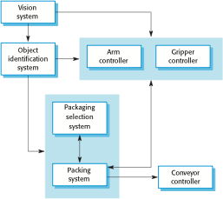
The architecture of a packing robot control system – Box and
Figure 8: Architecture of Robot Control System

Slide 46
Architectural design decisions – common questions (though a creative process)
Is there a generic application architecture that can be used?
How will the system be distributed?
What architectural styles are appropriate?
What approach will be used to structure the system?
How will the system be decomposed into modules?
What control strategy should be used?
How will the architectural design be evaluated?
How should the architecture be documented?

Slide 47
Architecture reuse
Systems in the same domain often have similar architectures that reflect domain concepts.
Application product lines are built around a core architecture with variants that satisfy particular customer requirements.
The architecture of a system may be designed around one of more architectural patterns or ‘styles’.
These capture the essence of an architecture and can be instantiated in different ways.
Discussed later in this lecture.

Slide 48
Architecture and system characteristics
Performance
Localise critical operations and minimise communications. Use large rather than fine-grain components or replicate.
Security
Use a layered architecture with critical assets in the inner layers.
Safety
Localise safety-critical features in a small number of sub-systems.
Availability
Include redundant components and mechanisms for fault tolerance.
Maintainability
Use fine-grain, replaceable components.

Slide 49
4 + 1 view model of software architecture
A logical view, which shows the key abstractions in the system as objects or object classes.
A process view, which shows how, at run-time, the system is composed of interacting processes.
A development view, which shows how the software is decomposed for development.
A physical view, which shows the system hardware and how software components are distributed across the processors in the system.
Related using use cases or scenarios (+1)

Slide 50
Architectural patterns
Patterns are a means of representing, sharing and reusing knowledge.
An architectural pattern is a stylized description of good design practice, which has been tried and tested in different environments.
Patterns should include information about when they are and when the are not useful.
Patterns may be represented using tabular and graphical descriptions.

Slide 51
The user interface
User interfaces should be designed to match the skills, experience and expectations of its anticipated users.
System users often judge a system by its interface rather than its functionality.
A poorly designed interface can cause a user to make catastrophic errors.
Poor user interface design is the reason why so many software systems are never used.
51

Slide 52
Importance of User Interface
“Most important part of any computer system”
“Interface is the system for most users”
Increasingly important
GUIs a big improvement over previous approaches
Platforms (e.g. Mac/ Microsoft) have style guides
50% of code devoted to interface
Interface should “disappear” – users can focus on
their task, not the interface
Biggest enemy of good interface design is time
52

Slide 53
Graphical user interfaces
Most users of business systems interact with these systems through graphical interfaces although, in some cases, legacy text-based interfaces are still used
Characteristic | Description
Windows | Multiple windows allow different information to be displayed simultaneously on the user’s screen.
Icons | Icons different types of information. On some systems, icons represent files; on others, icons represent processes.
Menus | Commands are selected from a menu rather than typed in a command language.
Pointing | A pointing device such as a mouse is used for selecting choices from a menu or indicating items of interest in a window.
Graphics | Graphical elements can be mixed with text on the same display.
53

Slide 54
GUI advantages
They are easy to learn and use.
Users without experience can learn to use the system quickly.
The user may switch quickly from one task to another and can interact with several different applications.
Information remains visible in its own window when
attention is switched.
Fast, full-screen interaction is possible with immediate access to anywhere on the screen
6

Slide 55
Human factors in interface design
Limited short-term memory
People can instantaneously remember about 7 items of information. If you present more than this, they are more liable to make mistakes.
People make mistakes
When people make mistakes and systems go wrong, inappropriate alarms and messages can increase stress and hence the likelihood of more mistakes.
People are different
People have a wide range of physical capabilities. Designers should not just design for their own capabilities.
People have different interaction preferences
Some like pictures, some like text.
7

Slide 56
Design principles
User familiarity
The interface should be based on user-oriented
terms and concepts rather than computer concepts. For example, an office system should use concepts such as letters, documents, folders etc. rather than directories, file identifiers, etc.
Consistency
The system should display an appropriate level
of consistency. Commands and menus should have the same format, command punctuation should be similar, etc.
Minimal surprise
If a command operates in a known way, the user should be able to predict the operation of comparable commands
8

Slide 57
Design principles
Recoverability
The system should provide some resilience to
user errors and allow the user to recover from errors. This might include an undo facility, confirmation of destructive actions, 'soft' deletes, etc.
User guidance
Some user guidance such as help systems, on-line
manuals, etc. should be supplied
User diversity
Interaction facilities for different types of user should be supported. For example, some users have seeing difficulties and so larger text should be available
57

Slide 58
Design issues in UIs
Two problems must be addressed in interactive systems design
How should information from the user be provided to the computer system?
How should information from the computer system be presented to the user?
User interaction and information presentation may be integrated through a coherent framework such as a user interface metaphor.
58

Slide 59
Interaction styles
Direct manipulation: The user interacts directly with objects on the screen, such as a mouse, touch screen
... etc
Menu selection: The user selects a command from a list of possibilities ( a menu).
Form fill-in: The user fills in the fields of a form
Command language: The user issues a special command and associated parameters to instruct the system what to do
Natural language: The user issues a command in natural language that must be parsed into command language
11

Slide 60
Interaction styles
Interaction style
Direct manipulation
Main advantages
Main disadva ntages
Application examples
Video games CAD systems
Fast and intuitive interaction
Easy to learn
May be hard to implement. Only suitable where there is a visual metaphor for tasks and objects.
Slow for expe rienced users. Can beco me complex if many menu options.
Takes up a lot of screen space. Causes problems where user options do not match the form fields.
Hard to learn.
Poor error manage ment.
Menu selection
Avoids user error Little typing required
M ost general-
purpose systems
Form fill-in
Simple data entry Easy to learn Checkab le
Stock control, Personal loan proces sing
Command language
Powerful and flexible
Op erating systems, Command and control systems
Information retrieval systems
Natural language
Accessible to casual users
Easily extended
Requires more typing.
Natural language und erstanding systems are un reliable.
12

Slide 61
Direct manipulation
Advantages
Users feel in control of the computer.
User learning time is relatively short.
Users get immediate feedback on their actions so mistakes can
be quickly detected and corrected.
Disadvantages
The derivation of an appropriate information space model can
be very difficult
Given that users have a large information space, what facilities for navigating around that space should be provided?
Direct manipulation interfaces can be complex to program and make heavy demands on the computer system
13

Slide 62
Control panel interface
Title
JSD. example
Grid
Busy
Method
JSD
OUIT
Type
Network
Units
cm
Selection
Process
Reduce
Full
PRINT
NODE
LINKS
FONT
LABEL
EDIT
62
Figure 9: Control Panel Interface

Slide 63
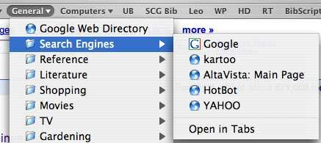
Menu systems
Users make a selection from a list of possibilities.
The selection may be made by pointing and clicking with a
mouse, using cursor keys or by typing the name of the selection
May make use of simple-to-use terminals such as touchscreens
63
Figure 10: Menu system

Slide 64
Menu systems
Advantages
Users need not remember command names
Typing effort is minimal
User errors are trapped by the interface
Context-dependent help can be provided.
Problems
Actions which involve logical conjunction (and) or disjunction (or) are awkward to represent
Menu systems are best suited to presenting a small number of choices. If there are many choices, some menu structuring facility must be used
16

Slide 65
Form-based interface
NEW BOOK
Title
ISBN
Author
Price
Publication date
Number of copies
Publisher
Edition
Classification
Loan status
Order status
Date of purchase
17
Figure 10: Form Based Interface

Slide 66
Command interfaces
User types commands to give instructions to the system e.g.
UNIX
May be implemented using cheap terminals.
Easy to process using compiler techniques
Commands of arbitrary complexity can be created by command
combination
Concise interfaces requiring minimal typing can be created
Problems
Users have to learn and remember a command language. Command interfaces are therefore unsuitable for occasional users
Users make errors in command. An error detection and recovery
system is required
System interaction is through a keyboard so typing ability is required
18

Slide 67
Sample Commands in UNIX
# Find all files in /usr/bin which are not documented in
/usr/man/man1 with source in /usr/src:
% cd /usr/bin %
mv old.html new.html
gcc file.c -o file
67

Slide 68
Natural language interfaces
The user types a command in a natural language. Generally, the vocabulary is limited and these systems are confined to specific application domains (e.g. timetable enquiries)
NL processing technology is now good enough to make these interfaces effective for casual users but experienced users find that they require too much typing
68

Slide 69
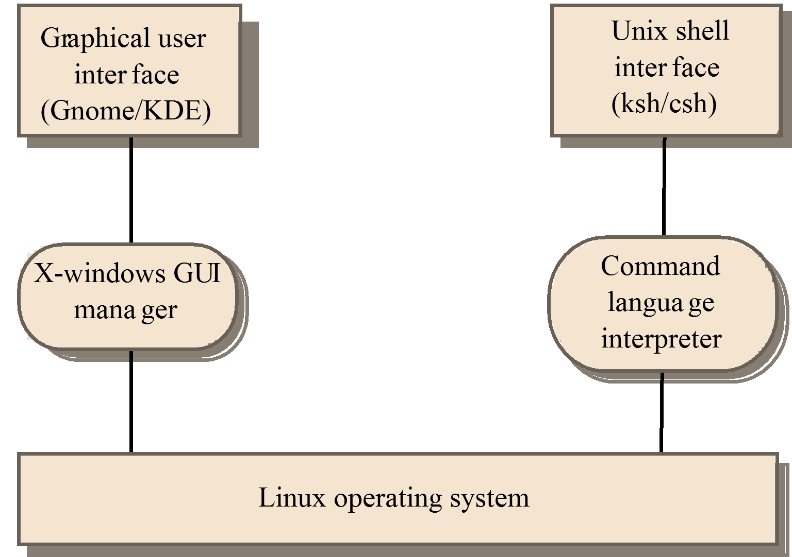
Multiple user interfaces
69
Figure 11: Multiple User Interface

Slide 70
LIBSYS interaction
Document search
Users need to be able to use the search facilities to find the documents that they need.
Document request
Users request that a document be delivered to their machine or to a server for printing.
70

Slide 71
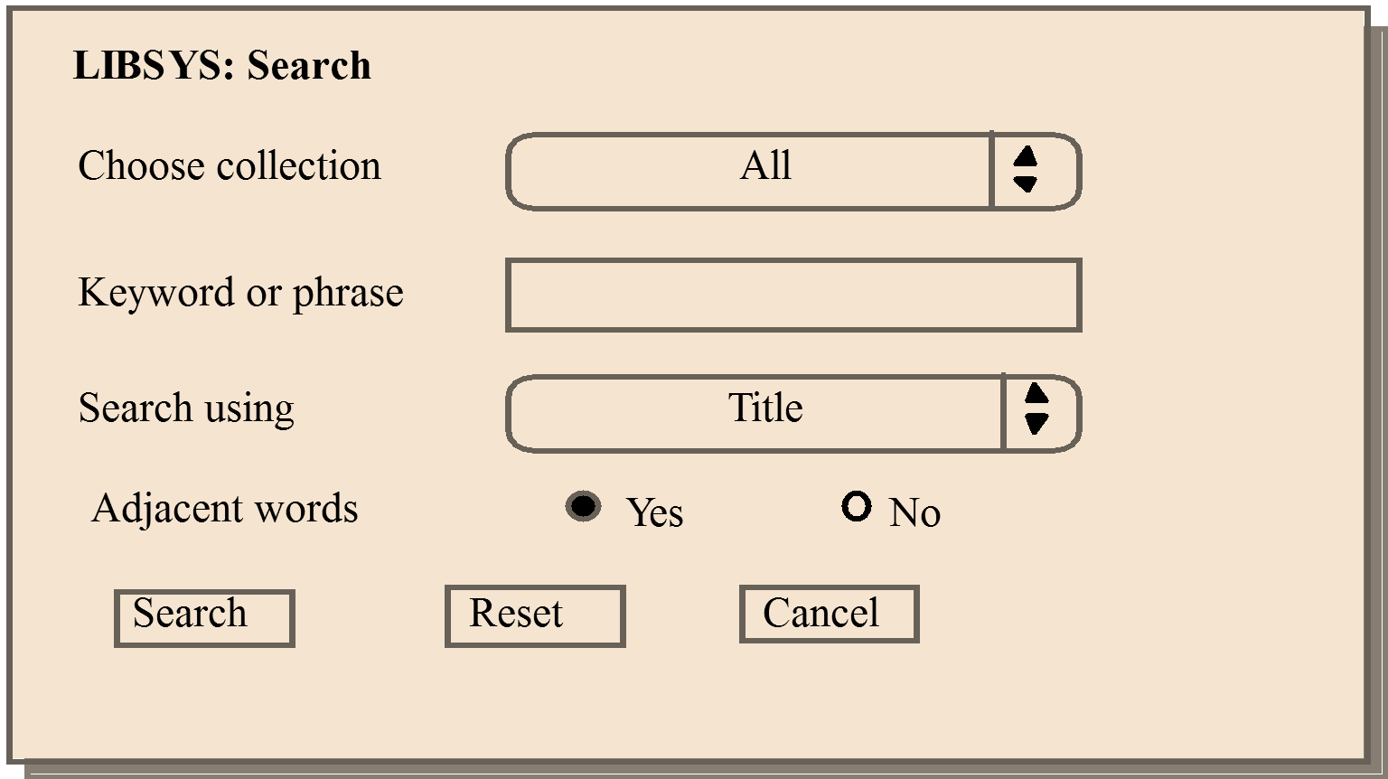
LIBSYS search form
Figure 11: LIBSYS search Form

Slide 72
Information presentation
Information presentation is concerned with presenting system information to system users.
The information may be presented directly (e.g. text in a word processor) or may be transformed in some way for presentation (e.g. in some graphical form).
72

Slide 73
Practice Questions
What Is System Design?
What is load balancing, and why is it important in system design?
How are performance and scalability related to each other?
How do you approach system design?
Which is the primary tool for structured design?
Can you name some metrics for measuring system performance?
There are basic approaches in Integration testing: Top down, bottom up. Discuss each one of them.
What are the pros and cons of bottom-up models versus top-down models?

Slide 74
THANKS
74

